Slide 1



Customer Behaviour Analysis Project
Task 1
Objective:- Customer Behaviour Analysis
Company:- Alfido Tech
Tech Stack:- Python(Pandas, Seaborn, Matplotlib)

Slide 2
Overview
01

Slide 3



Introduction
This project aims to analyze customer behavior to understand purchasing patterns, preferences, and trends.
The analysis helps uncover underlying factors influencing customer decisions in a competitive market environment.

Slide 4
Problem Statement
The primary goals are to identify and analyze key behavioral trends, segment customers by demographics and purchasing patterns, and generate strategic insights. These insights enable targeted marketing campaigns, optimized product offerings, and improved customer relationship management, ultimately driving business growth and competitive advantage in a dynamic market environment.

Slide 5
Data Cleaning
02

Slide 6
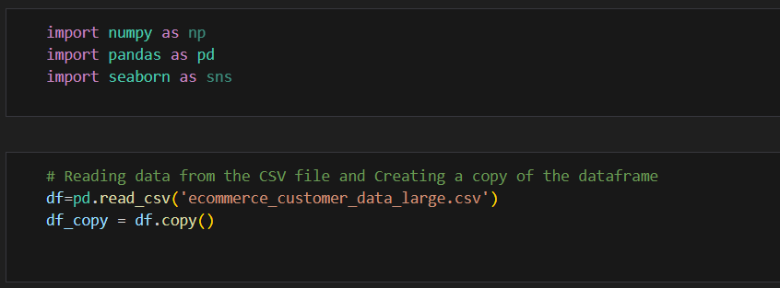
Importing Libraries and Reading
Data from CSV File
We import NumPy, Pandas, and Seaborn to handle numerical operations, data manipulation, and visualization. The CSV file is read into a Pandas DataFrame, and a copy is created to preserve the original dataset for safe analysis.

Slide 7
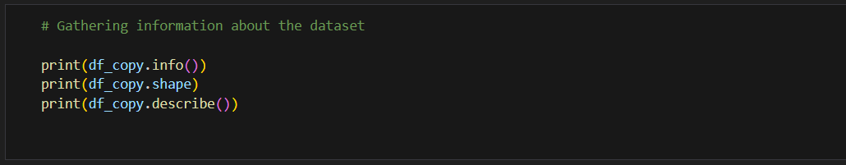
Gathering Information about
the Dataset
The dataset is first explored to gain a clear understanding of its structure and contents. Using info(), we can check the column names, data types, and presence of null values. The shape attribute provides the number of rows and columns, helping us gauge the dataset’s size. Finally, describe() generates summary statistics such as mean, median, minimum, maximum, and standard deviation for numerical columns, giving an initial overview of the data distribution and helping identify any irregularities or patterns.

Slide 8
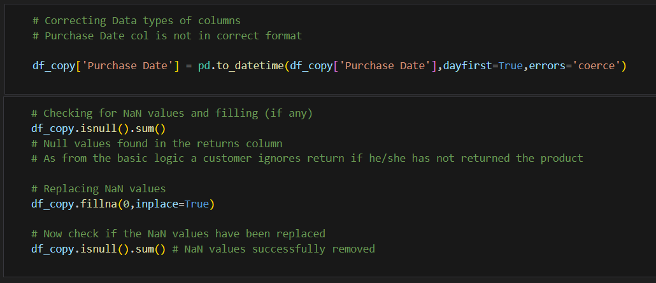
Data Cleaning Code 1
In this step, the dataset is cleaned to make it ready for analysis. The Purchase Date column is converted into a proper datetime format to ensure consistency. Next, the dataset is checked for any missing values using isnull().sum(), and null entries are handled by replacing them with zeros using fillna(0, inplace=True). This ensures that the data remains complete, avoids calculation errors, and maintains logical consistency, especially in cases like returns where a missing value can reasonably be treated as zero.

Slide 9
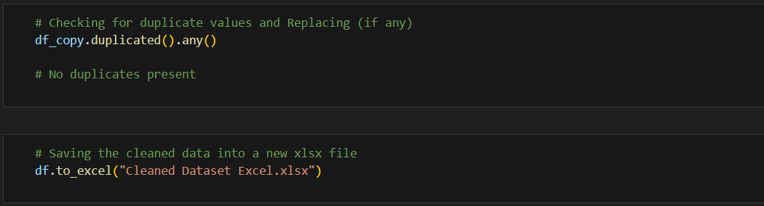
Data Cleaning Code 2
The dataset is further cleaned by checking for duplicate records using duplicated().any(), ensuring that each entry is unique and reliable. Since no duplicates are found, the data is already consistent. Finally, the cleaned dataset is saved into a new Excel file using to_excel(), making it ready for future analysis and reporting.

Slide 10
Data Visualization and Analysis
03

Slide 11

Visuals Used
The analysis incorporated various visual tools including bar charts, pie charts, KPI’s, tables, and scatter plots to illustrate customer segmentation, purchase behaviors, and Payment mode preferences. These visualizations enhance data comprehension by clearly highlighting significant trends, relationships, and outliers, thereby facilitating informed decision-making and strategic planning.

Slide 12
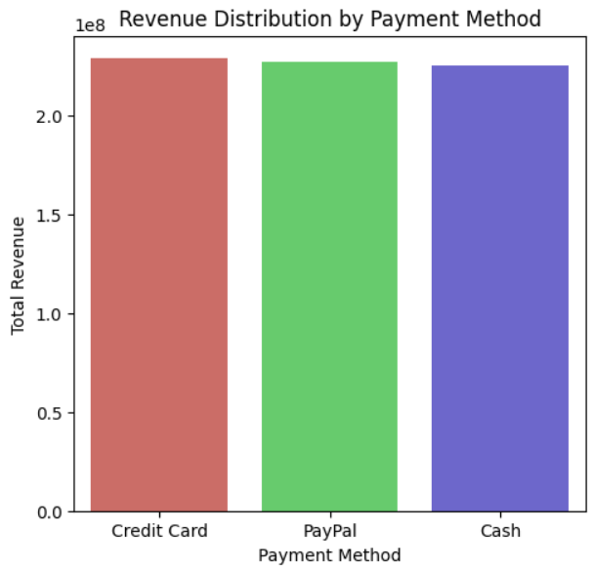
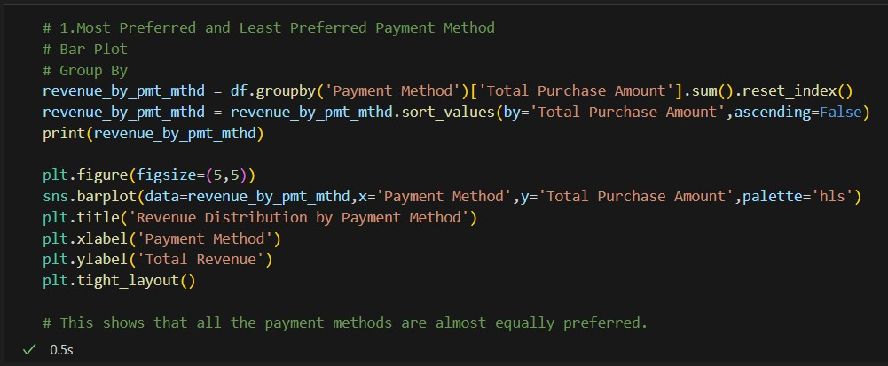
Visual 1

Slide 13
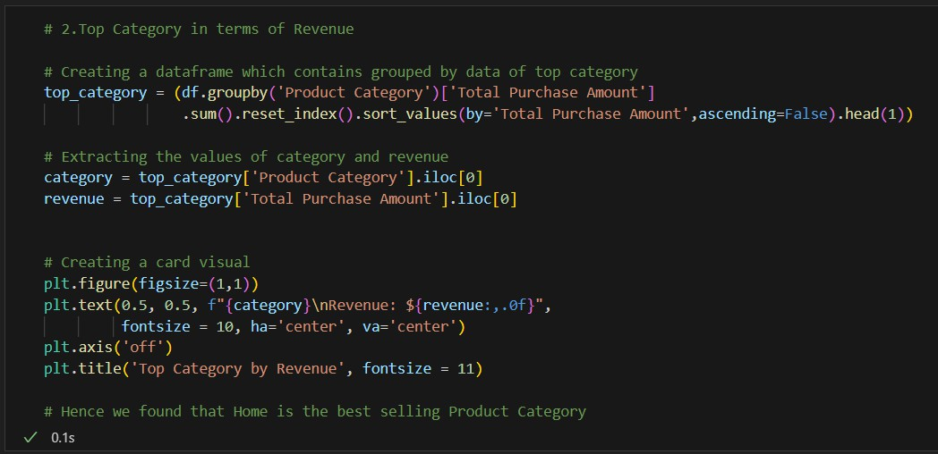
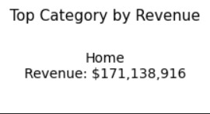
Visual 2

Slide 14
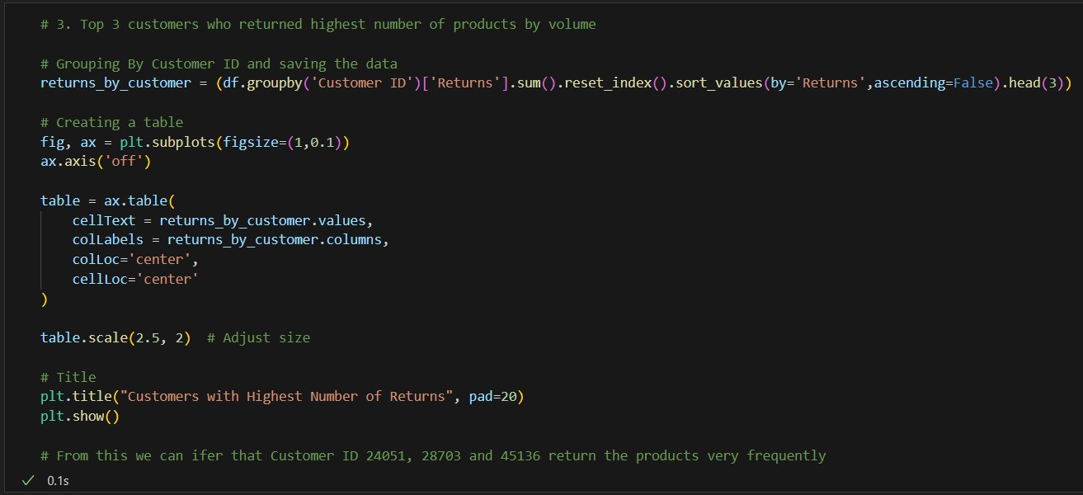
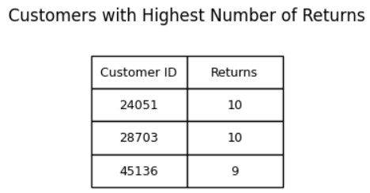
Visual 3

Slide 15
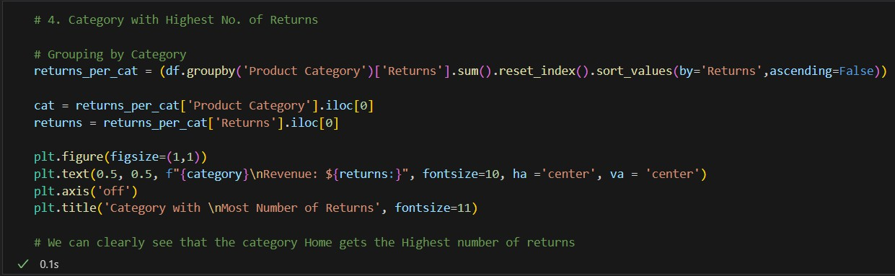
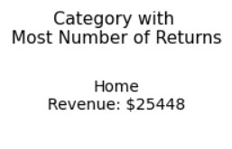
Visual 4

Slide 16
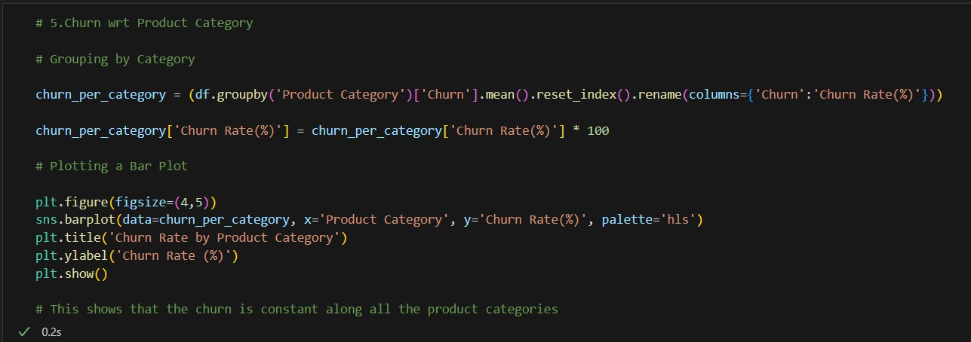
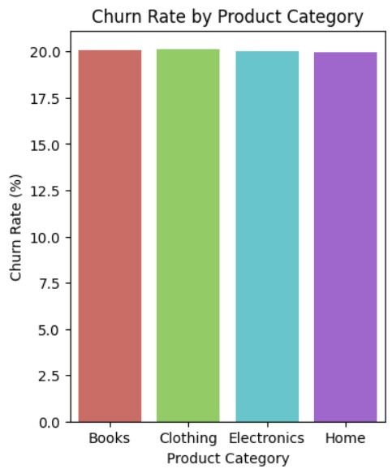
Visual 5

Slide 17
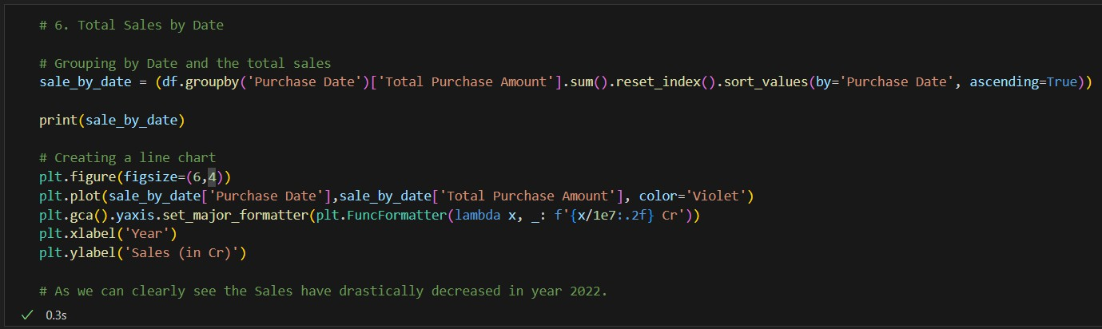
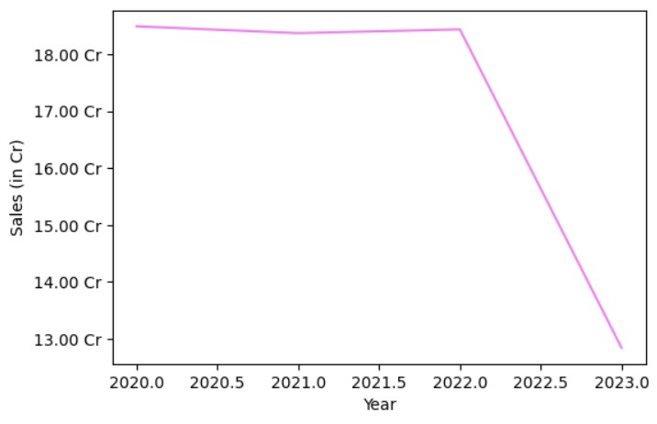
Visual 6

Slide 18
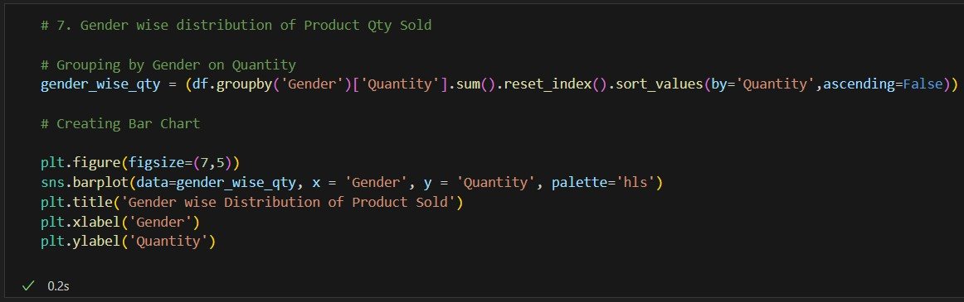
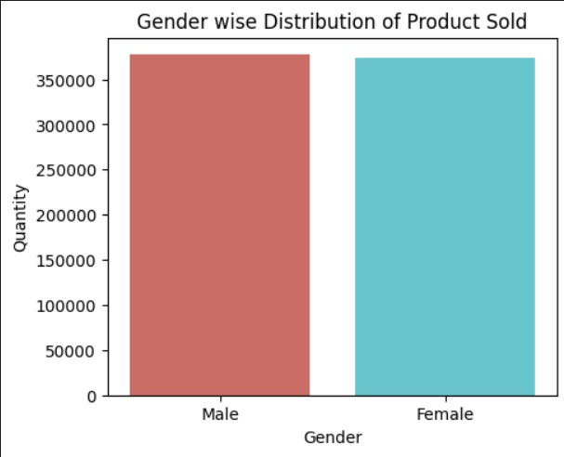
Visual 7

Slide 19
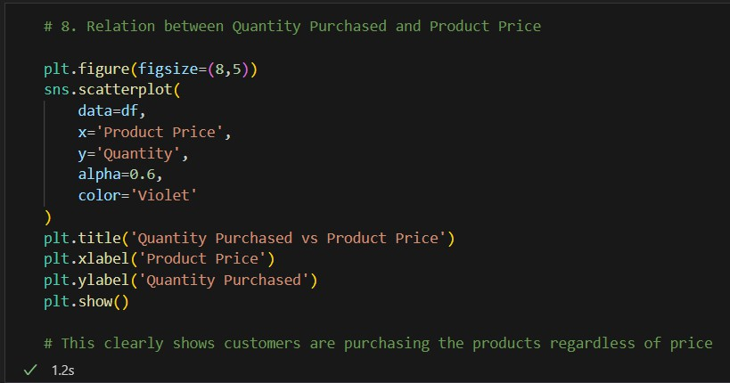
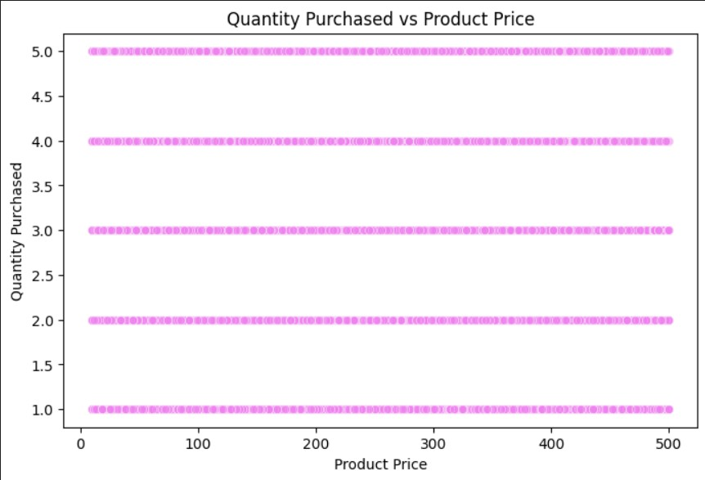
Visual 8

Slide 20
Insights and Decision Making
04

Slide 21
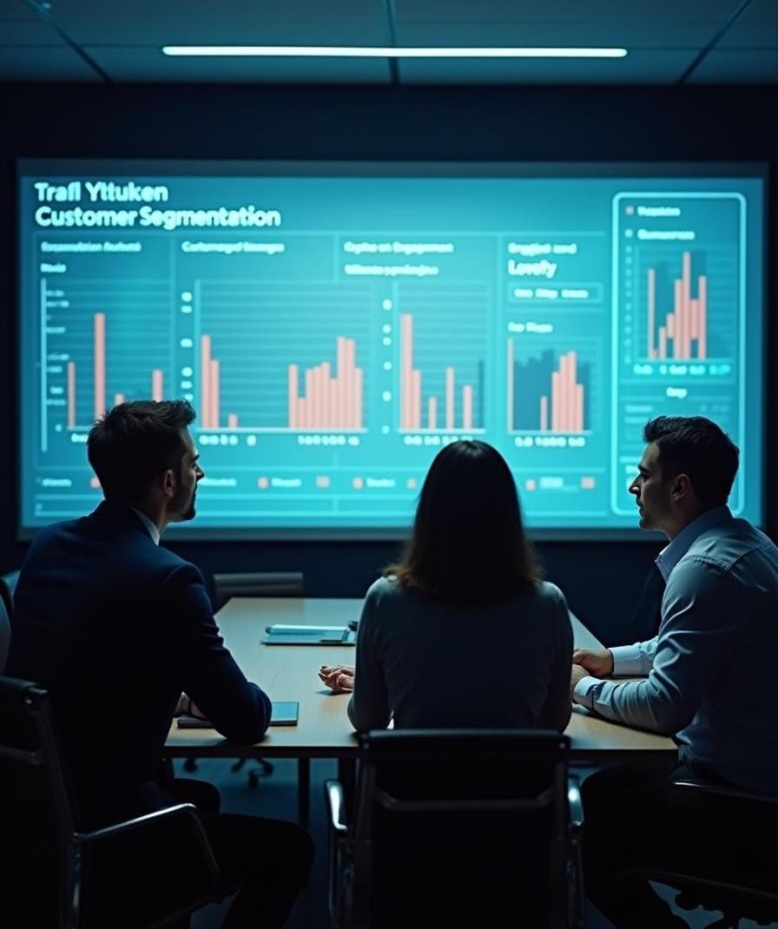
Key Insights
Customers use all payment methods (Credit Card, PayPal, Cash) almost equally, showing no dominant preference.
The Home category generates the highest revenue ($171M+), but also records the
largest number of returns ($25K+).
A few specific customers are responsible for frequent product returns, indicating possible dissatisfaction or unusual buying behavior.
Churn rate is steady at around 20% across all product categories, suggesting customer drop-off is not category-specific.
Sales remained stable during 2020–2021 but experienced a sharp decline in 2022,
raising concerns about retention or market changes.
Gender-wise sales distribution shows near-equal contributions from male and female customers, reflecting balanced demand across demographics.
Price vs. Quantity analysis indicates no significant link between higher prices and lower
purchase quantities, suggesting demand is not strongly price-sensitive.

Slide 22
Recommendations for Decision Makers
Investigate the high return rate in the Home category by improving product quality checks, enhancing descriptions, and strengthening after-sales service.
Continue offering multiple payment options to maintain customer convenience and inclusivity.
Address the consistent churn rate by introducing loyalty programs, personalized offers, and better
engagement initiatives to retain customers across categories.
Examine the 2022 sales decline through customer feedback, competitive analysis, and market research, followed by corrective actions such as targeted promotions or pricing adjustments.
Leverage the balanced gender demand by designing inclusive marketing campaigns that appeal to both male and female customers.
Take advantage of the price-insensitive demand by introducing premium product lines, bundling strategies, or upselling opportunities, while ensuring strong brand positioning and product quality.

Slide 23
THANK YOU

